Slide 1
Big Mountain Ski Resort
Elie Park

Slide 2
What opportunities exist for Big Mountain Resort to optimize its investment strategy to increase its ticket price and decrease its operating cost to recoup for $1,540,000?
The price of the current weekday/weekend ticket is set to $81.00, the market average. In order to match the recent increase in operating costs of $1,540,000 due to the implementation of new chairlifts, we can consider raising the price point based on analysis of ski resorts in the market, or cutting costs to reduce ticket price.

Slide 3
Key Findings by State
The state of Montana has the 13th most resorts in the country, is the third largest state, and is less densely populated.
Alaska is the largest state and California is the highest in state population.
New York has the highest number of resorts with smaller total skiing area, but highest night skiing area. - # of weekday/weekend tickets sold might be worth exploring. NY’s resorts per capita and per area were not significant.
Colorado has a high number of resorts, high skiing area, and highest number of days open.
Vermont has the most resorts per capita, and most resorts per area after New Hampshire

Slide 4
Model Analysis: Trends in Ski Resort Features
When resorts are more densely located with population, more night skiing is provided.
Visitors value more guaranteed snow than skiable terrain which drives costs and prices up
As the number of resorts serving a population increases, ticket price also increases as it is indicative of an area with more demand
The more chairs a resort has, the lower the ticket price, but more information about the number of annual visitors is necessary

Slide 5
Recommendations for Increase in Ticket Price
According to the price points based on resort characteristics nationwide, Big Mountain’s ticket price can be increased to $95.87, with an expected mean absolute error of $10.39. ($85.48 ~ $106.26)
To explain this error, it must be considered that the prices that the other resorts charge may not be optimized as well.
Total number of customers and operating costs of lifts may help with the accuracy of our findings
Data containing more ski resorts would not be helpful as 40-50 is the optimal sample size

Slide 6
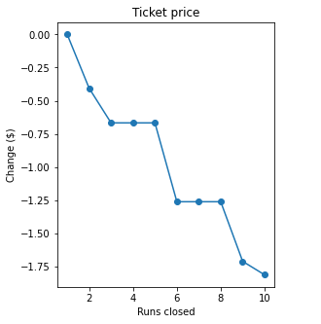
Recommendations for Increase in Revenue: 1. Closing Runs
The figure on the right shows the predicted change in ticket price for the number of runs closed, given that each of the expected visitors buys 5 tickets.
Closing one run makes no difference to the change in ticket price.
Closing 2, 3, 6, 9, or 10 least used runs seems to make sense to effectively reduce ticket price.

Slide 7
Recommendations for Increase in Revenue: 2. New Run
Increasing the vertical drop & installing an additional chairlift for a new run increases support for the ticket price by $1.99 and eventually $3,474,638 over the season.

Slide 8
Model Analysis: Other Avenues to Consider/Disregard
These opportunities do not make any difference in the ticket price:
Adding 2 acres of snowmaking (too small of an area)
Increasing the longest run by 0.2 miles and adding 4 acres of snowmaking
The graph on the next slide shows that the dominant 4 features that may be most correlated with ticket price in the final model are:
fast Quads (not tested)
Runs (tested: success)
Snow Making (tested for 2 acres: failure)
Vertical drop (tested: success)

Slide 9
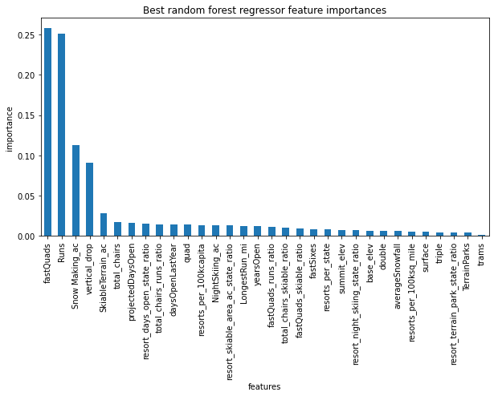

Slide 10
Model Analysis: Market Comparison of Big Mountain Resort
Other features that came up as important in not just our final model but the whole analysis were:
Vertical drop
Snow making area
Total chairs
Fast Quads
Runs
Longest run
Trams
Skiable Terrain
Compared to all other resorts, Big Mountain sits high at each of these features other than trams, which a vast majority of resorts also don’t have. Its weekend ticket price is rather high, charging the highest price among Montana resorts.

Slide 11
Conclusion
Increase in revenue:
The installation of a chairlift (preferably fast quad) for a new run which increases the vertical drop
Reducing the number of slower chairlifts (need to close more than one run)
Increase in ticket price:
Must be considered even if there is a decrease in ticket prices from above
The expected error in the predicted ticket cost based on the market can still be reduced with more data

